Slide 1
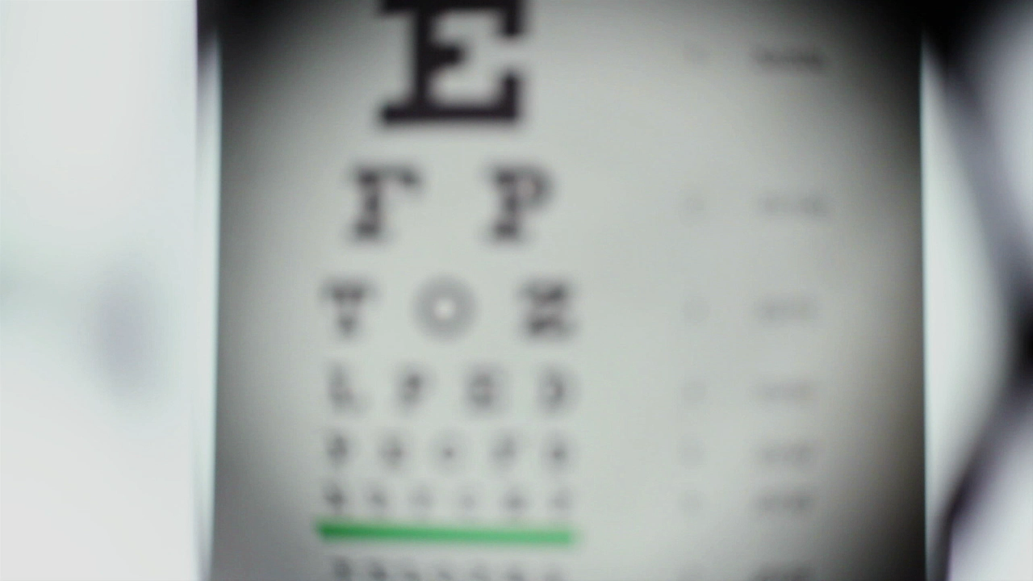
Diet Object Detection Part 2

Slide 2

Let’s recap

Slide 3
Original Objectives
Classify IDC Histological images: Successful
Draw bounding boxes around cancerous cells: Sort of…

Slide 4
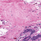
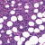
Data

Slide 5
Model
_________________________________________________________________
Layer (type) Output Shape Param #
=================================================================
conv2d_49 (Conv2D) (None, 25, 25, 124) 9424
_________________________________________________________________
dropout_49 (Dropout) (None, 25, 25, 124) 0
_________________________________________________________________
conv_layer_42_IDC (Conv2D) (None, 13, 13, 248) 769048
_________________________________________________________________
flatten_49 (Flatten) (None, 41912) 0
_________________________________________________________________
dense_49 (Dense) (None, 2) 83826
=================================================================
Total params: 862,298
Trainable params: 862,298
Non-trainable params: 0
Loss: Categorical Crossentropy
Activation: Softmax
Early Stopping: Would monitor validation loss and a patience of 5
Epochs: 50

Slide 6
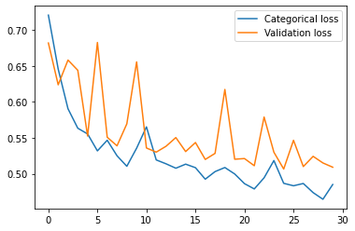
Results after 35 epochs
Accuracy: 0.7649
Loss: 0.4852
Validation Loss: 0.5092

Slide 7

Now draw boxes

Slide 8
Problems
Data images are just snippets
We would need a different algorithm

Slide 9
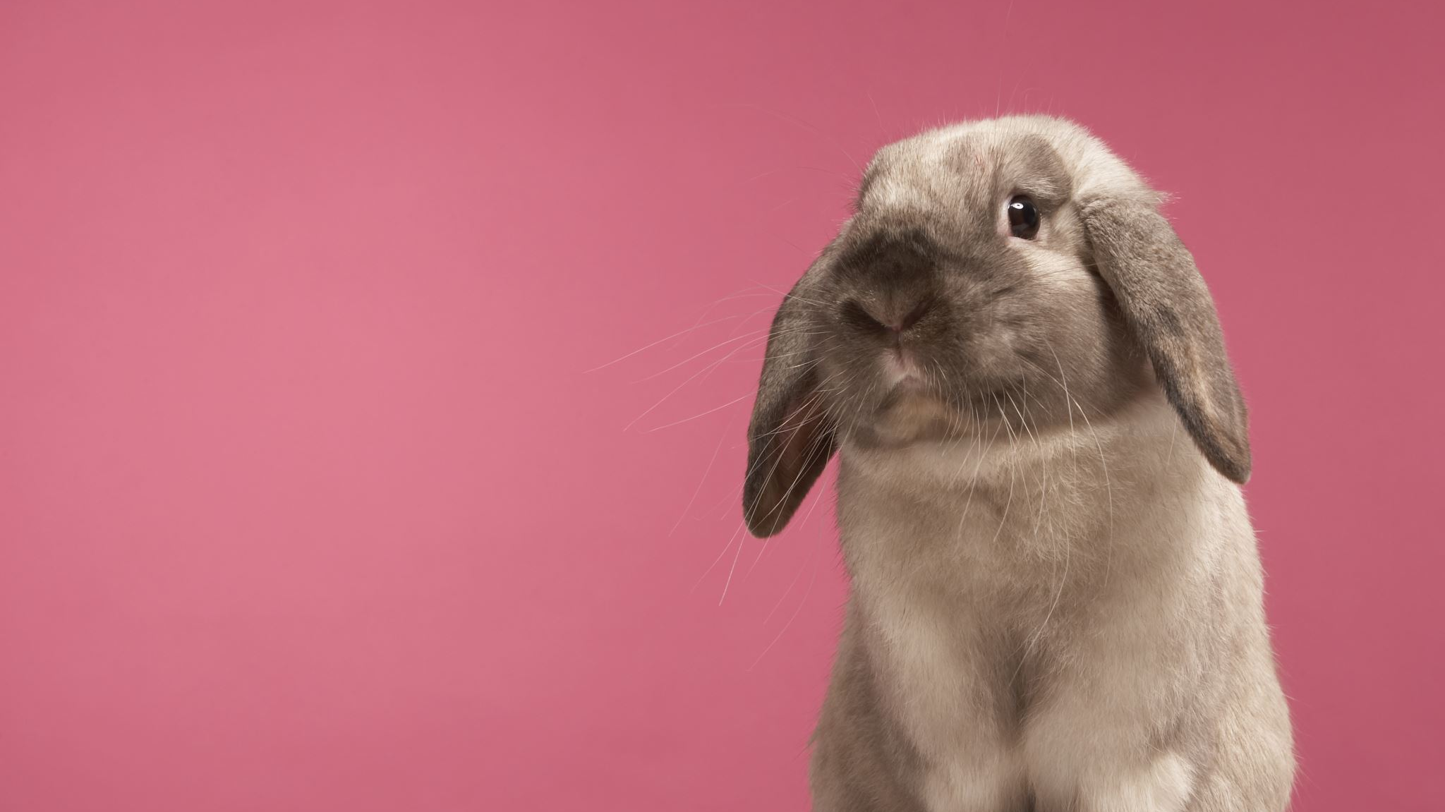
Down the rabbit hole of object detection

Slide 10
A CNN is not enough we need more!
There are many different algorithms!

Slide 11
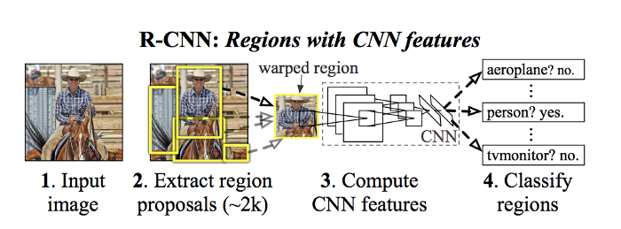
Regional CNN or R-CNN
We use a CNN as a sliding window
We use something called selective search to get proposed regions

Slide 12
Super slow!
We are essentially training a CNN ~2000 times per image!

Slide 13
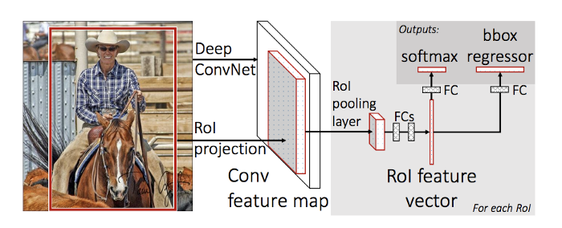
Fast R-CNN
Selective Search is fixed!
There is another algorithm called Faster R-CNN but we can do better

Slide 14
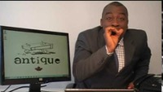

Slide 15
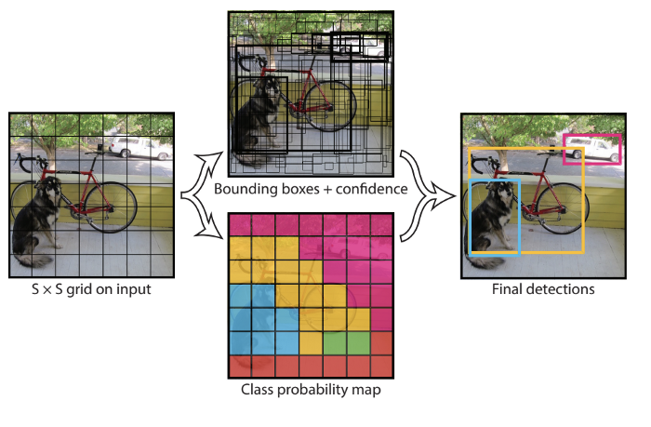
You Only Look Once
Notes:
How YOLO works is that we take an image and split it into an SxS grid, within each of the grid we take m bounding boxes. For each of the bounding box, the network outputs a class probability and offset values for the bounding box. The bounding boxes having the class probability above a threshold value is selected and used to locate the object within the image.

Slide 16

Bigger Problem
I would need a lot of preprocessed data!

Slide 17

If you remember to last week…

Slide 18
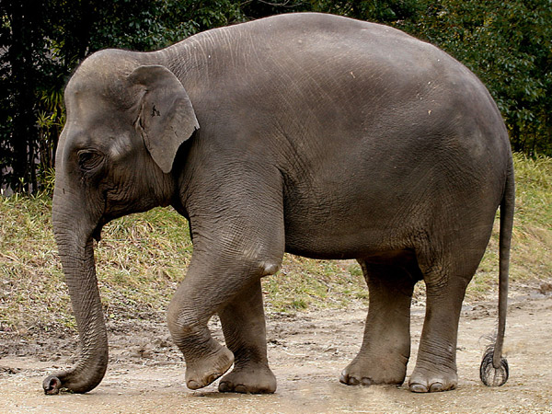
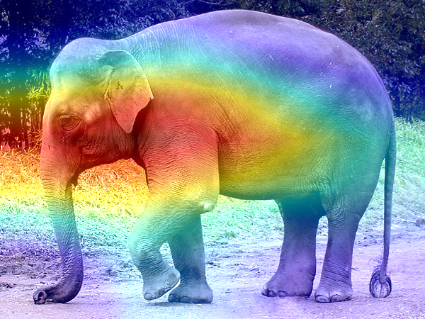
Gradient Class Activation Map (CAM)
Close enough
TL;DR: We use the gradients to make a heatmap

Slide 19
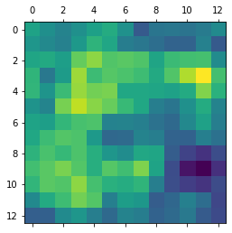
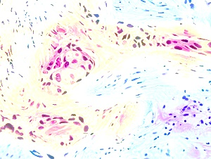
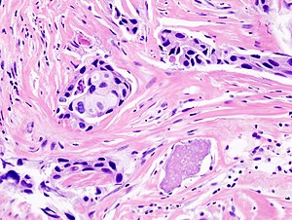
Grad-CAM of IDC

Slide 20

Round 2 using chest-xrays

Slide 21
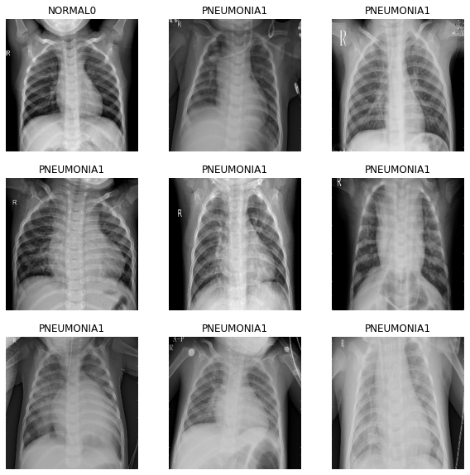
Data
Pneumonia

Slide 22
Model
_________________________________________________________________
Layer (type) Output Shape Param #
=================================================================
conv2d_1 (Conv2D) (None, 128, 128, 124) 9424
_________________________________________________________________
dropout_1 (Dropout) (None, 128, 128, 124) 0
_________________________________________________________________
conv_layer_42_XRAY (Conv2D) (None, 64, 64, 248) 769048
_________________________________________________________________
flatten_1 (Flatten) (None, 1015808) 0
_________________________________________________________________
dense_1 (Dense) (None, 1) 1015809
=================================================================
Loss: Binary Crossentropy
Activation: Sigmoid
Early Stopping: Would monitor validation loss and a patience of 5
Epochs: 50

Slide 23
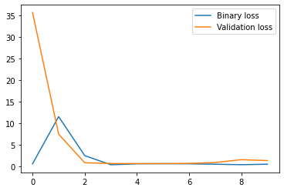
Results after 10 epochs
Accuracy: 0.6562
Loss: 0.5422
Validation Loss: 1.3743
Keep training it and it will overfit

Slide 24
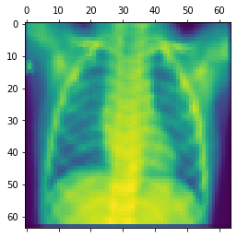
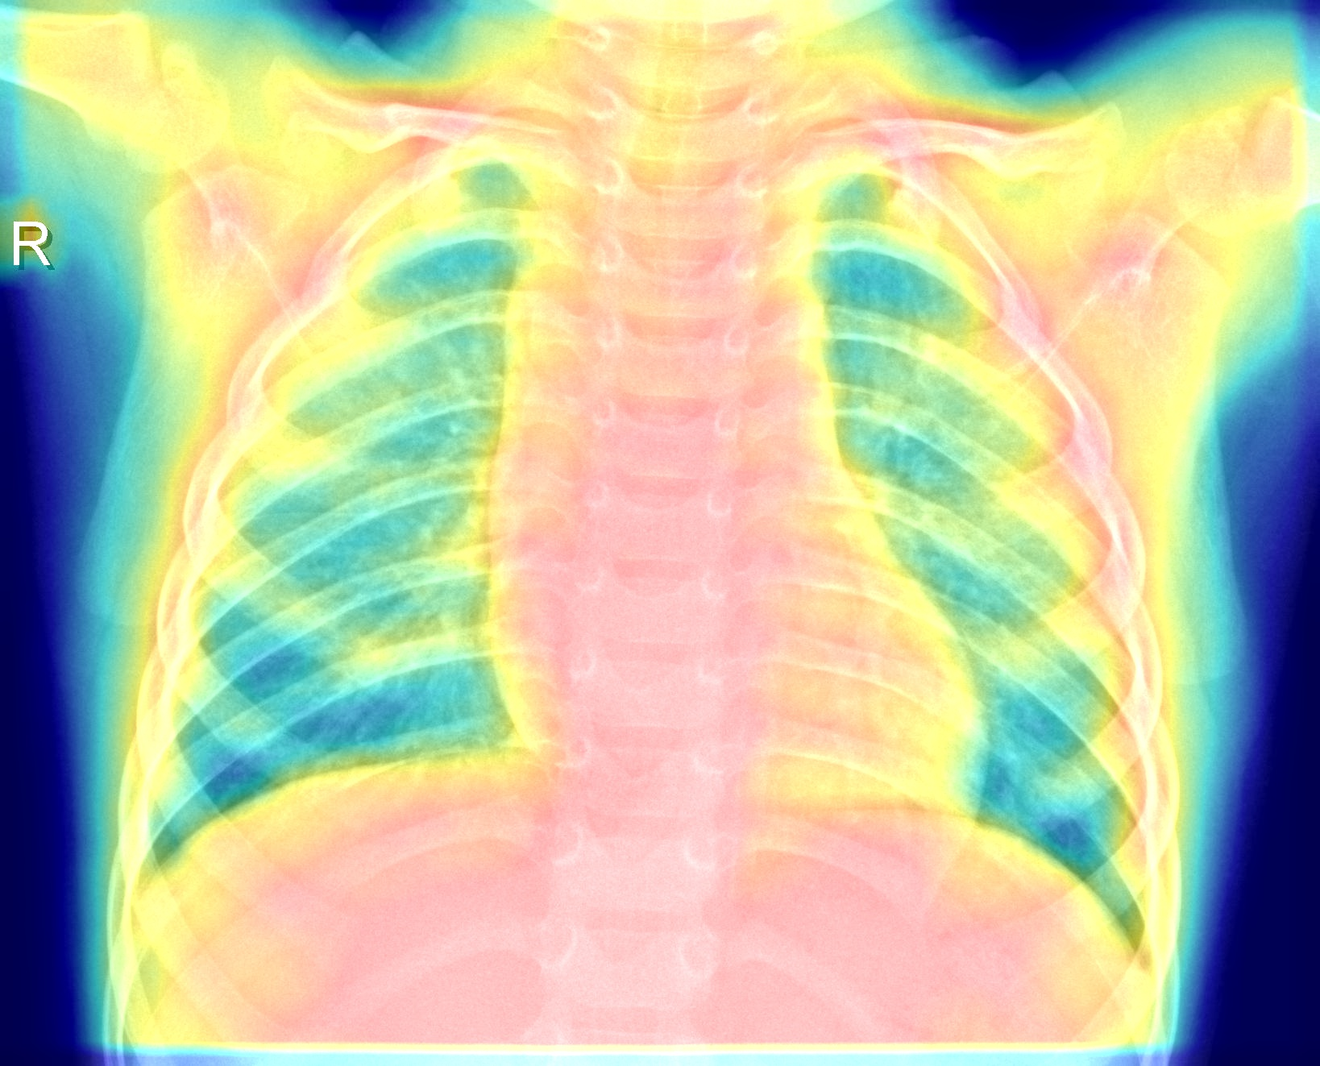
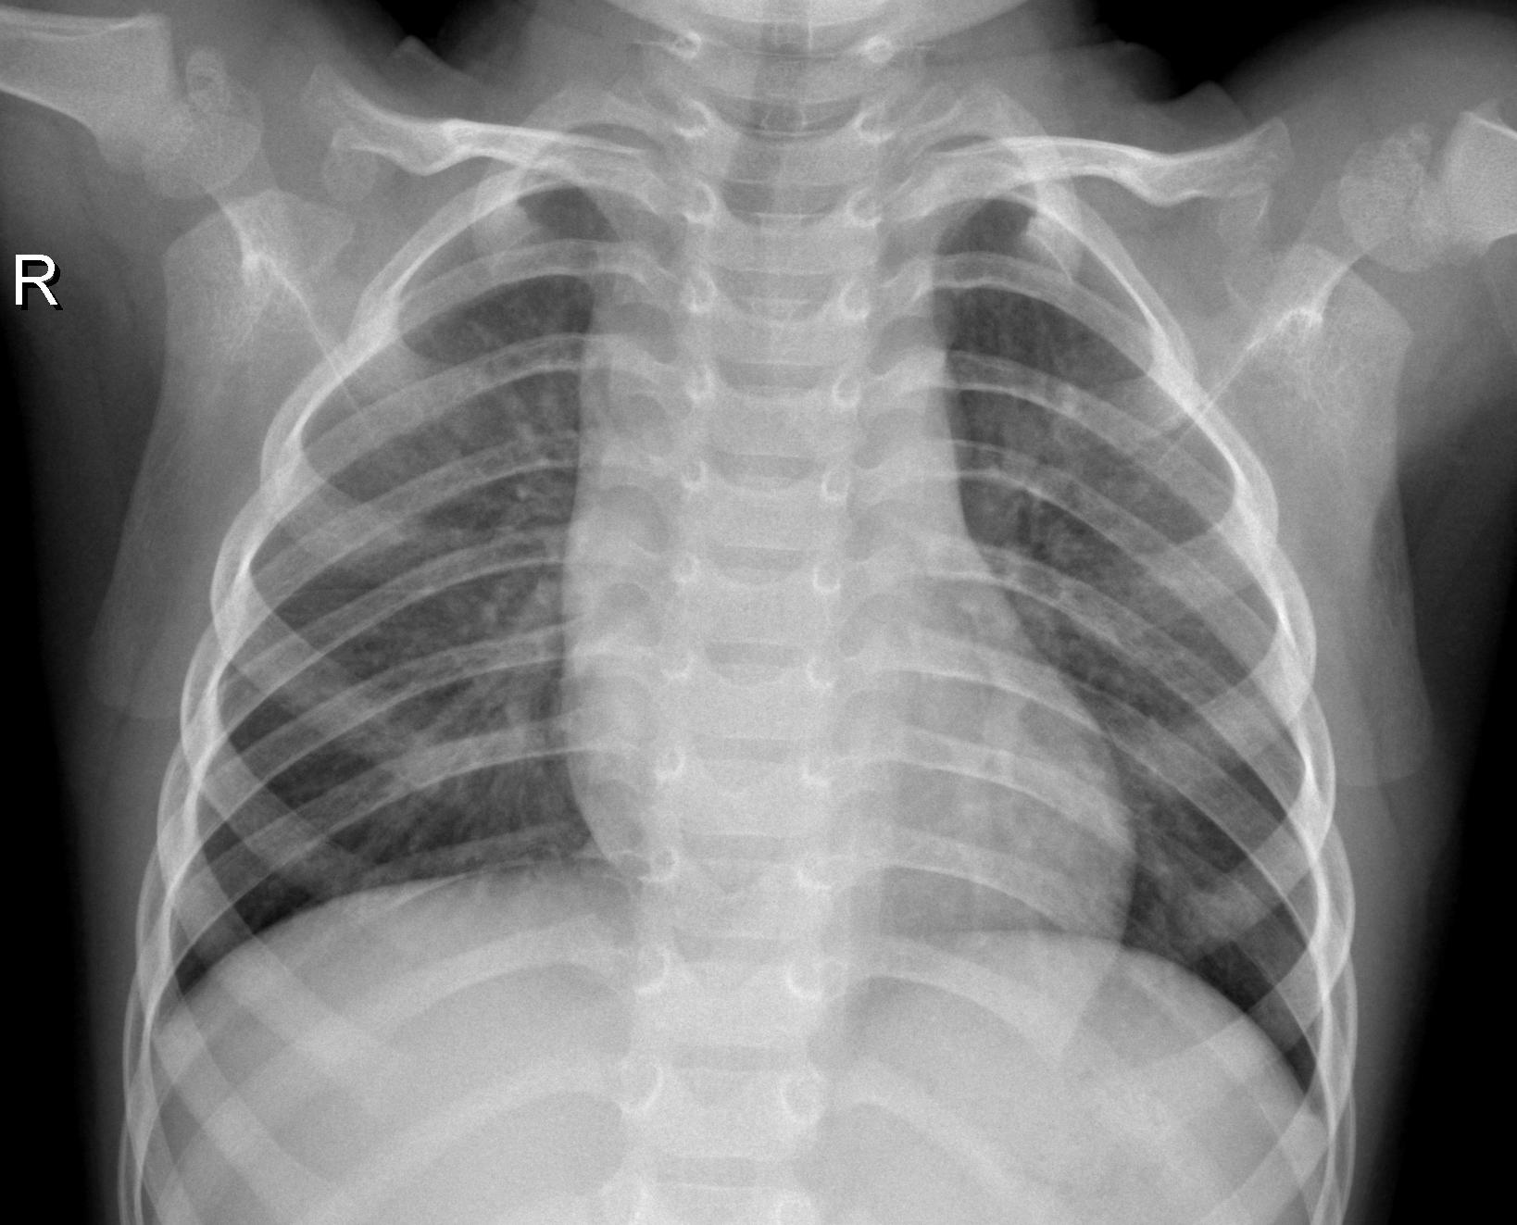
Gram of XRAYs
This is a normal xray but CNN classified it as having pnuemonia

Slide 25
Sources
https://medium.com/analytics-vidhya/visualizing-activation-heatmaps-using-tensorflow-5bdba018f759
https://keras.io/examples/vision/grad_cam/
https://towardsdatascience.com/r-cnn-fast-r-cnn-faster-r-cnn-yolo-object-detection-algorithms-36d53571365e
https://www.tensorflow.org/tutorials/load_data/images
https://www.kaggle.com/paultimothymooney/breast-histopathology-images (for reference)

Slide 26
Data
https://www.kaggle.com/simjeg/lymphoma-subtype-classification-fl-vs-cll
https://www.kaggle.com/paultimothymooney/chest-xray-pneumonia

